Slide 1

Introduction to the Python World
Kevin Cunningham

Slide 2
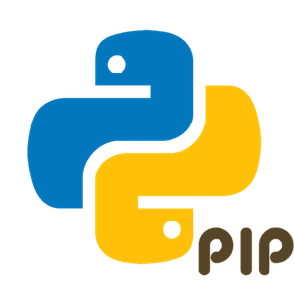
Plan for Session
Execution Model
Running Python Programs
Python IDEs
Where to get Python
Common Python Libraries
Python PIP Environments
Useful Online Resources

Slide 3
Python Programming Language
Originates in 1980s created by Guido van Rossum
Several versions current is Python 3.x
A Hybrid Dynamically Typed language
Allows for Procedural Programming
Supports Object Oriented Programming
Facilities Functional Programming
Has dynamic typing, Easily extendible
Has an extensive set of built in and third-party libraries
Graphics, UIs and Graphing
CSV, Excel and databases
Machine Learning and Data Science etc.
…

Slide 4
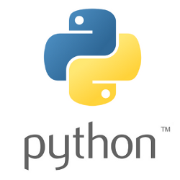
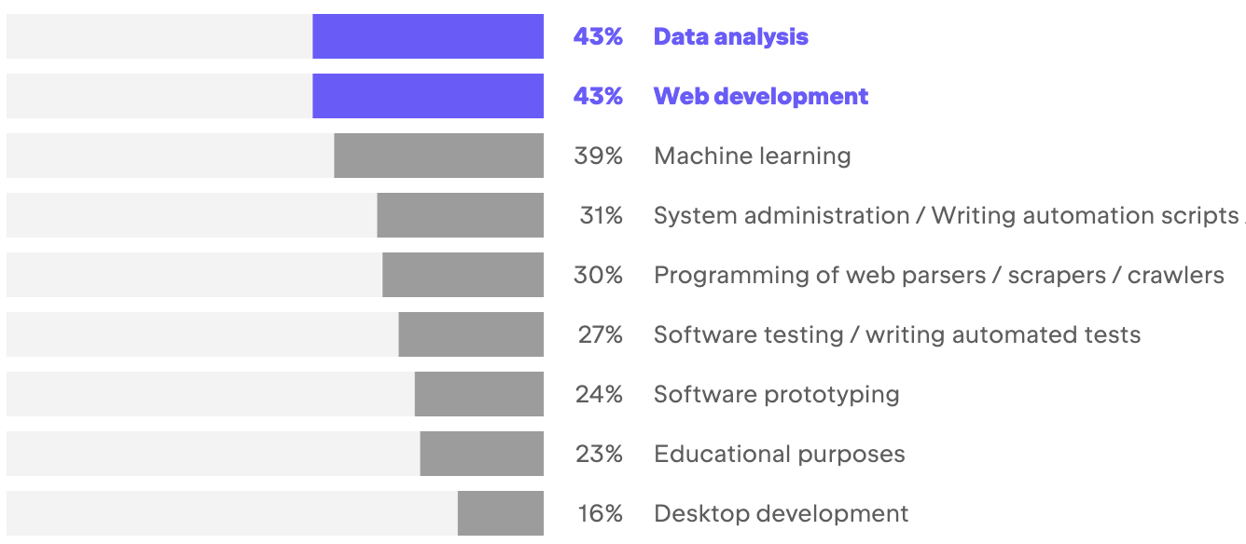
Where is Python Used?
Data Analysis & Web Development most common
Machine Learning catching up
https://www.jetbrains.com/lp/devecosystem-2022/python/

Slide 5


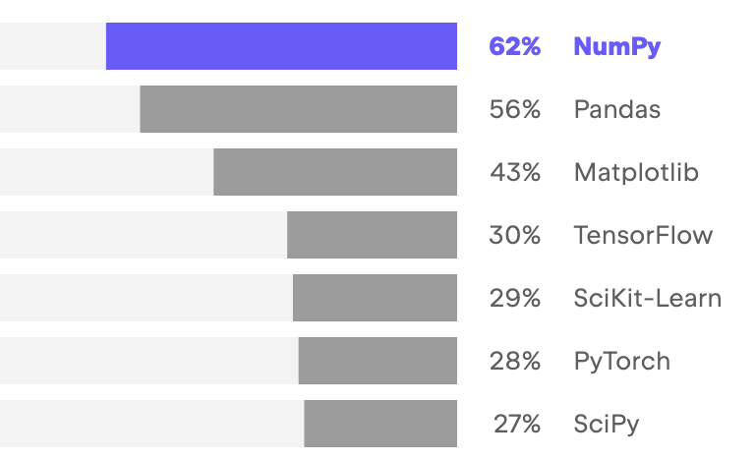
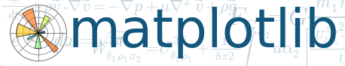

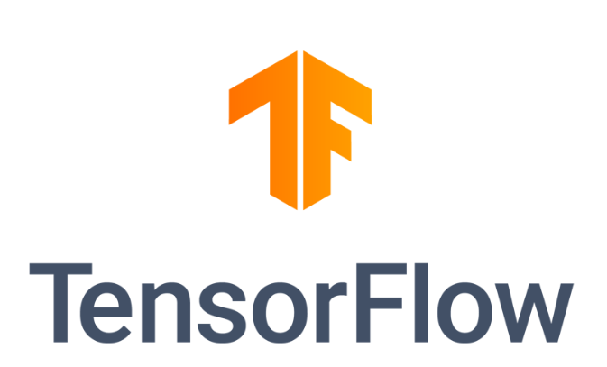

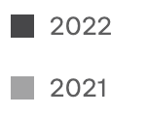
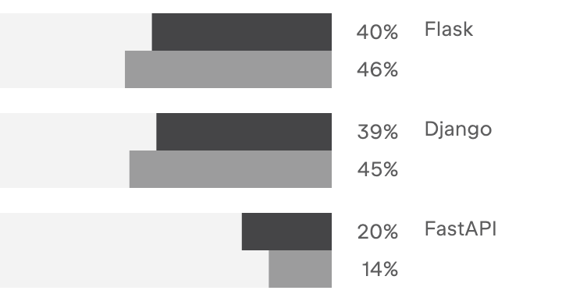


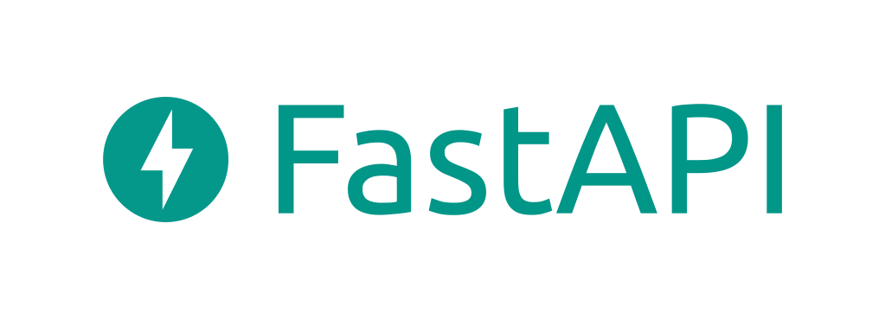
Common Python Libraries
https://www.jetbrains.com/lp/devecosystem-2022/python/
Data Science Libraries
Web Frameworks

Slide 6

Python Execution Model
Originates in 1980s created by Guido van Rossum
Not a precompiled language
But not exactly an interpreted language either
Simplified process illustrative of behaviour
Check the Program is valid and well formed
Python
hello.py
(Dynamically) Compile
Into the Intermediate language
Run the intermediate
version of the program
Notes:
The way in which the Python interpreter processes a Python program is broken down into several steps. The steps shown here are illustrative (and simplified) but the general idea is correct.
First the program is checked to make sure that it is valid Python, that is a check is made that the program follows all the rules of the language and that each of the commands and operations etc. is understood by the Python environment.
It then translates the plain text, English like commands, into a more concise intermediate format that is easier to execute on a computer. Python can store this intermediate version in a file which is named after the original file but with a ‘.pyc’ extension instead of a ‘.py’ extension (the ‘c’ in the extension indicates it contains the compiled version of the code).
The compiled intermediate version is then executed by the interpreter.

Slide 7
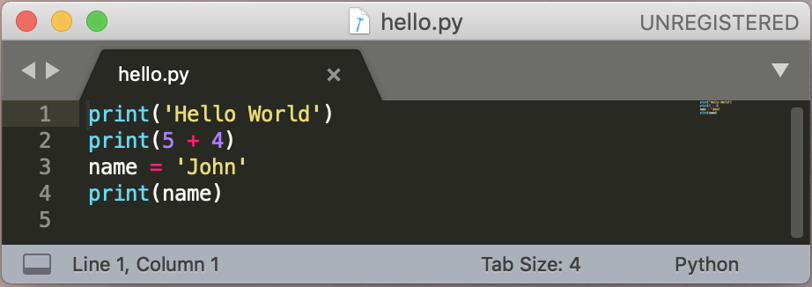
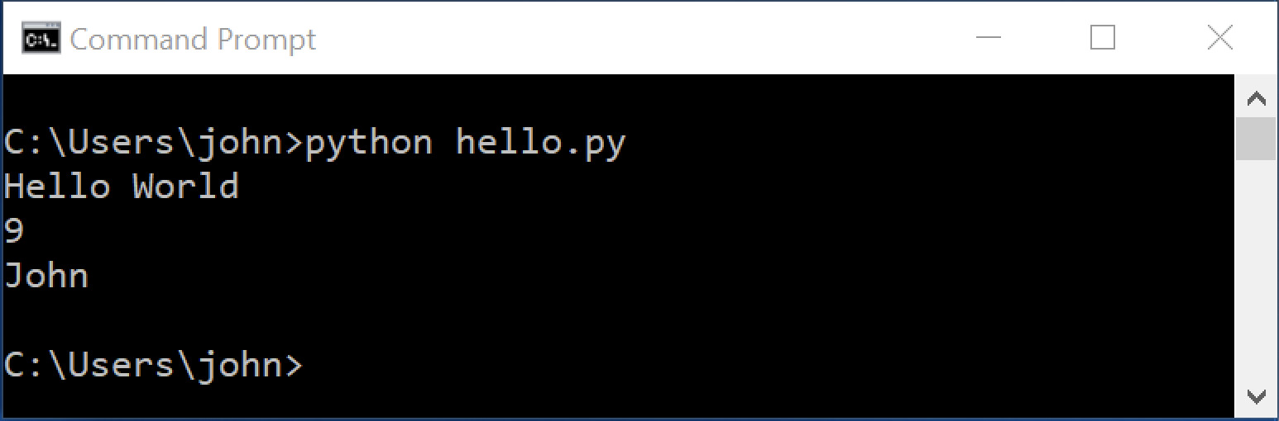
Running Python Programs
Commands stored in a file
with a .py extension
run the file using python command

Slide 8
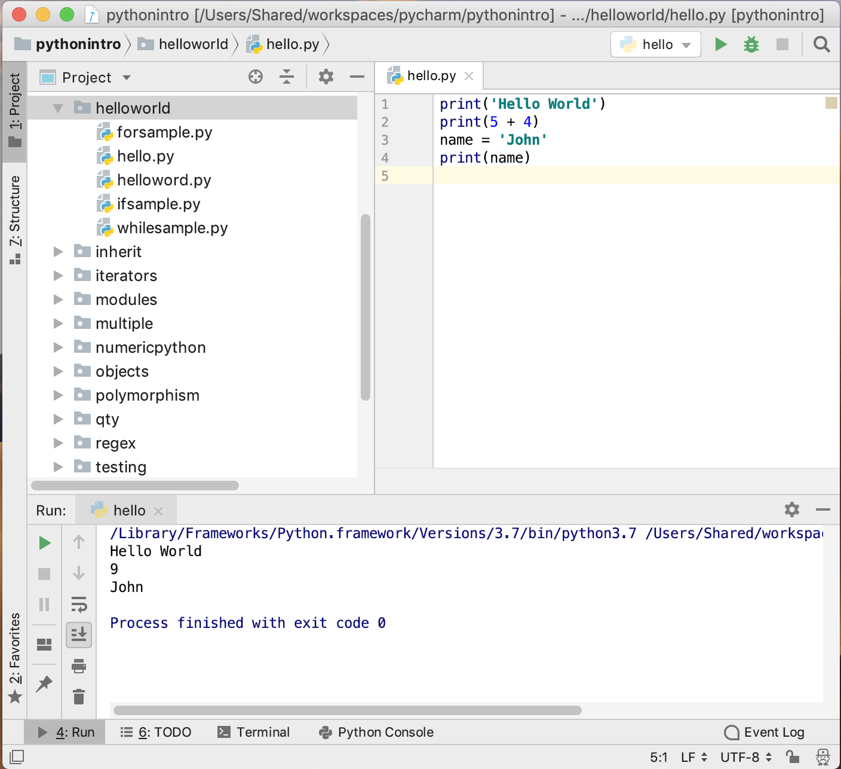
Python IDEs
Several Python IDEs available
PyCharm
both free version
and commercial
Visual Studio Code
Free IDE from Microsoft
Spyder
scientific dev apps
Eclipse + PyDev plugin
Jupyter Notebooks
target data analysis tasks

Slide 9
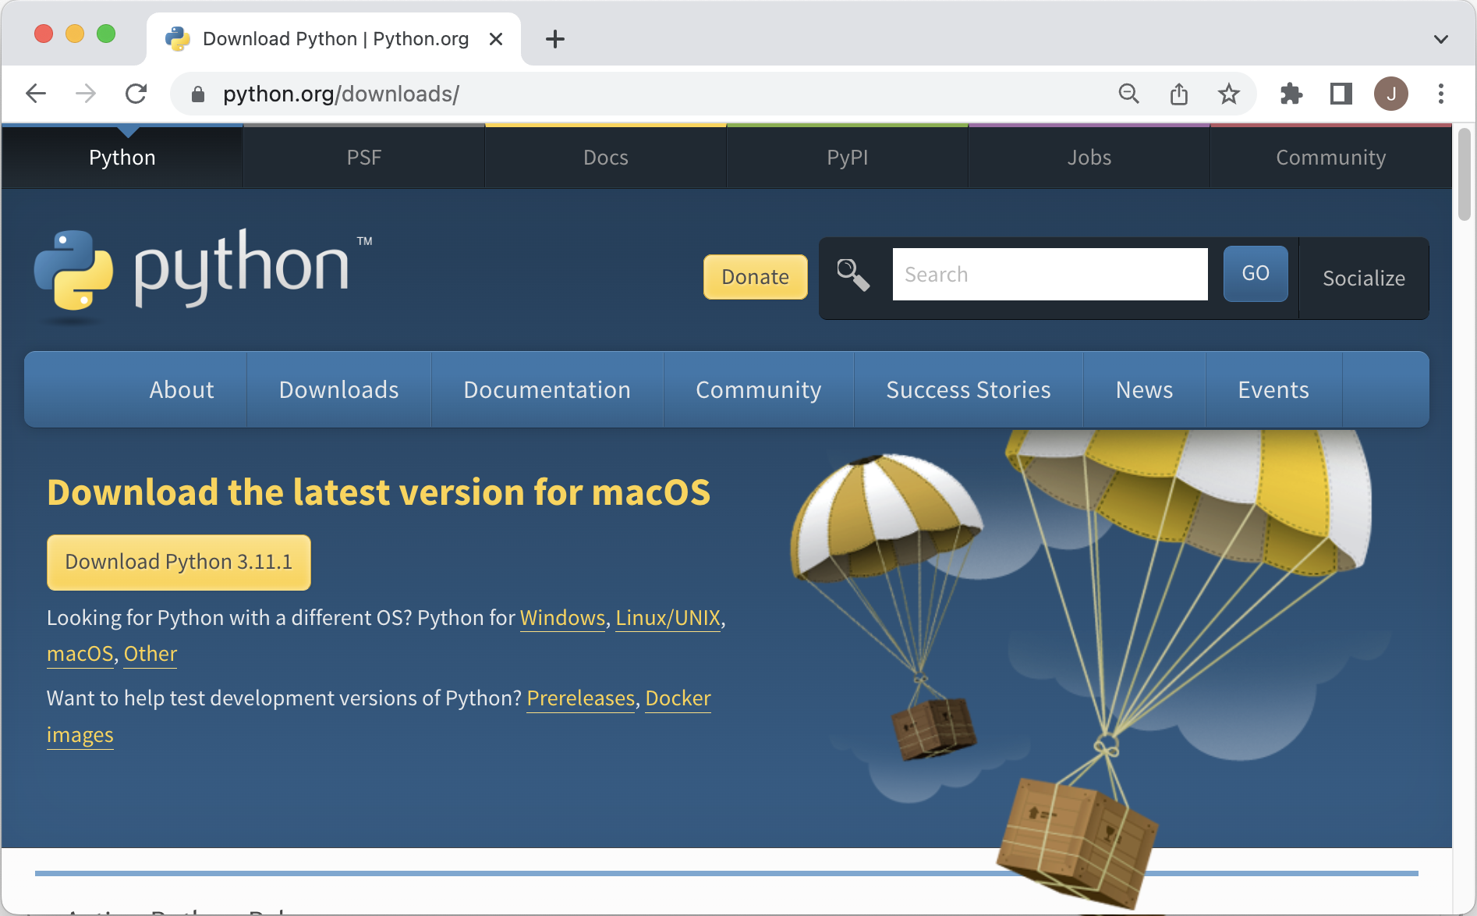
Where to get Python
https://www.python.org/downloads/

Slide 10
Common Python Libraries
https://www.jetbrains.com/lp/devecosystem-2022/python/
Data Science Libraries
Web Frameworks

Slide 11
Python Environments
Typically use a tool to handle Python environments
Required as may have different projects
that use different versions of Python 3.7, 3.8, 3.9, 3.10 etc.
that use different libraries NumPy, SciPy, Pandas, Matplotlib
and different versions of those libraries
Problem for Python
installs libraries for a Python runtime
by default globally on a machine
Two commonly used environment tools
pip virtual environments / conda environments

Slide 12
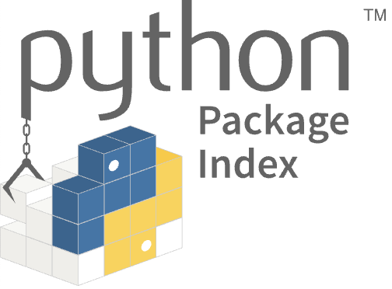
Pip and Virtual Environments
Can use virtual environments venv module
see https://docs.python.org/3/library/venv.html
tool to create isolated Python package configurations
included as part of Python3 and pip
use source to activate on Mac (or activate.bat on Windows)
Each virtual environment can have its own set up
Installs <whatever> in virtual env venv3 in current directory
from Python Package Index https://pypi.org/
$ python -m venv venv3
$ source venv3/bin/activate
(venv3)
$ pip install <whatever>

Slide 13
Working with Pip
Open a Command (Windows) or Terminal (Mac)
check installation
install package
create a virtual environment
to use or activate / deactivate the environment
update the pip installation
to see whats been installed
pip --version
pip install pandas
pip install pandas==1.5.2
python -m venv venvProj1
source venvProj1/bin/activate
deactivate
pip install --upgrade pip
pip freeze

Slide 14
Working with Pip
% mkdir bbclabs
% cd bbclabs
% python -m venv venv3
% source venv3/bin/activate
(venv3) % pip --version
pip 22.3.1 from ../bbclabs/venv3/lib/python3.11/site-packages/pip (python 3.11)
(venv3) % pip install pandas
Collecting pandas
Using cached pandas-1.5.3-cp311-cp311-macosx_10_9_x86_64.whl (11.9 MB)
Collecting python-dateutil>=2.8.1
Using cached python_dateutil-2.8.2-py2.py3-none-any.whl (247 kB)
Collecting pytz>=2020.1
Using cached pytz-2022.7.1-py2.py3-none-any.whl (499 kB)
Collecting numpy>=1.21.0
Using cached numpy-1.24.2-cp311-cp311-macosx_10_9_x86_64.whl (19.8 MB)
Collecting six>=1.5
Using cached six-1.16.0-py2.py3-none-any.whl (11 kB)
Installing collected packages: pytz, six, numpy, python-dateutil, pandas
Successfully installed numpy-1.24.2 pandas-1.5.3 python-dateutil-2.8.2 pytz-2022.7.1 six-1.16.0
(venv3) % deactivate
%

Slide 15
Useful Resources
Python Software Foundation
https://en.wikipedia.org/wiki/Python_Software_Foundation
The main Python 3 documentation site
https://docs.python.org/3/
List of all the builtin features
https://docs.python.org/3/library/index.html
Python 3 Module of the week site
https://pymotw.com/3
Python Resources
https://wiki.python.org/moin/BeginnersGuide/Programmers
W3 School Intro to Python
https://www.w3schools.com/python/

Slide 16
Questions?
?

